Slide 1

Book Recommendation System
Prepared by: Shaden Almangour

Slide 2
Outlines
01
02
03
04
Introduction
Approach
Result
Tools
05
Conclusion

Slide 3
01
Introduction

Slide 4
Introduction
The explosive growth in the amount of available information, and the number of visitors to the Internet has created a potential challenge of information overload which hinders timely access to items of interest. This has increased the demand for recommender systems more than ever before.
Notes:
This project is to recommend the next book for the user that may like it.

Slide 5
Introduction (Cont.)
Recommender systems are information filtering systems that deal with the problem of information overload by filtering vital information fragment out of a large amount of dynamically
generated information according to the user’s preferences, interests, or observed behaviour about the item.

Slide 6
Problem statement
People may have difficulties in choosing the right books or searching for books based on their interests, and this may take a long time.

Slide 7
The solution
To deal with this problem, the solution is a recommendation system that helps the user by providing the search for relevant suggestions to the users. This process is done by filtering based on the ratings of other users.

Slide 8
About the recommendation system
Recommendations typically speed up searches and make it easier for users to choose the books their other users were reading.
Suggestions
Recommended for you!
Popular books might you like
Most of the users have read this book, you might want to read it
Related books
Similarity book for your last read might you like .

Slide 9
02
Approach

Slide 10
Work Approach
Step 1
Step 2
Step 3
Step 4
Step 5
Data Collection
Data Clean
EDA
Modeling
Recommendation system
Notes:
Data cleaning: I changed the values of some columns where they were inverted
dealing with nan value by the nan publisher with other and drop missing value in book title
and remove the zeros from the rating which means that book not ratings

Slide 11
Step 1: Data Collection
About the dataset:
The data is collected from the Kaggle which is contains from 3 csv files
About the dataset:
Books: information of each book.
Ratings: User rating records for each book.
Users: User information (Age, Location)
Explore datasets:
The books dataset is containing 271360 entries, 5 columns
The user's dataset is containing 278858 entries, 3 columns
Ratings dataset is containing 526356 entries, 3 columns

Slide 12
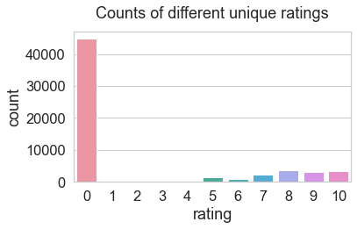
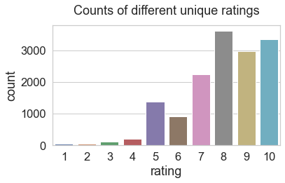
Step 3: Data Visualization
a. Number of book without rating
b. Removing the zeros value from rating

Slide 13
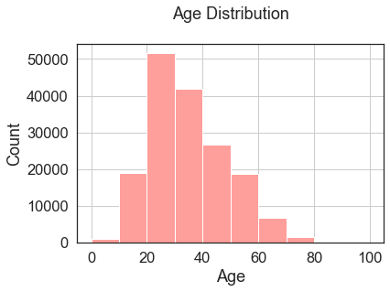
Step 3: Data Visualization
from the diagram we observed the most readers are between 20-30 years

Slide 14
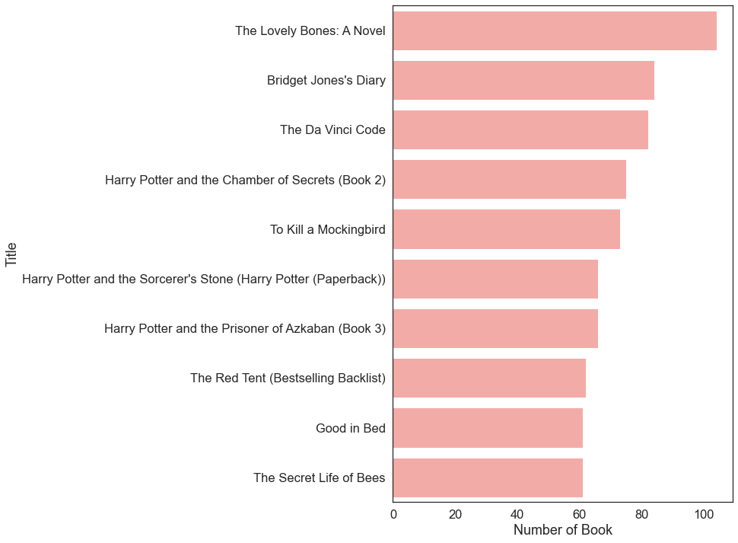
Step 3: Data Visualization
Top books rated by users

Slide 15
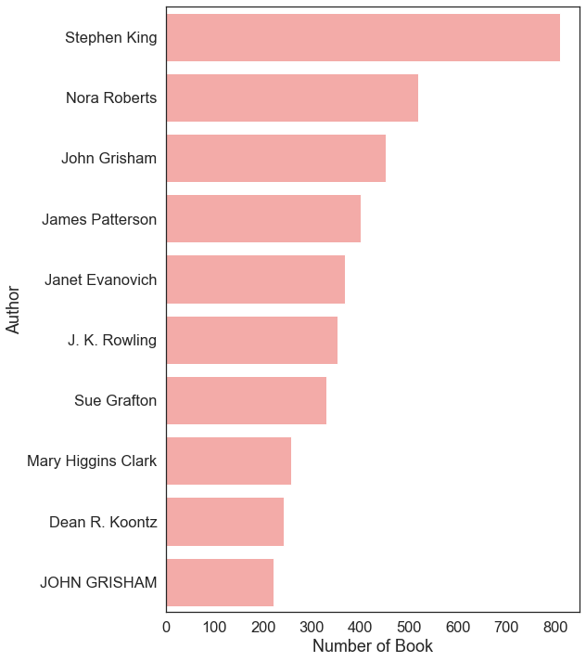
Step 3: Data Visualization
The authors per the most number of books

Slide 16
Prepare data for modeling
Extract 200 of users and ratings as a features.
Merge ratings with books
Extract books that have received more than 50 ratings, to reduce the dataset size.
Create a pivot table where columns are users and indexes are books and values are ratings.
Notes:
3. More than 11 users were removed because the books they rated did not reach 50 reviews

Slide 17
Matrix Factorization
Most famous and widely used Collaborative filtering technique.
In this project, the title, user-id and rating as a matrix, Aim is to find all these user and item dependencies in the matrix.
839 Users
User matrix
Item
matrix
742 books
Rating matrix
742 books
839 Users
Notes:
Since we have a lot of zeros in the pivot table, and in the clustering will increase the calculate the distance of zero so I will have to convert them by spars using the matrix.

Slide 18
Step 4: Modeling
Algorithm
K-Nearest Neighbors
(classification)
K Nearest
(clustering)
Notes:
I will use two models the first model is the nearest neighbors (Classification) model, using a brute algorithm, which will calculate the find the distance of every point to every other point.
to make a prediction I will use the result of the nearest neighbors model into the K nearest (Clustering ) model that gives me a good result.

Slide 19
Step 4: Modeling
Collaborative Filtering
The system generates recommendations using only information about rating profiles for different users or items. By locating peer users/items with a rating history similar to the current user or item, they generate recommendations using this neighborhood.
The k-nearest neighbors (KNN) algorithm
Supervised machine learning algorithm used to solve both classification and regression problems.
kneighbors
Unsupervised nearest neighbors learning which is used for clustering problem.
Notes:
I used in my project the nearest neighbors algorithm which is the same as K nearest which is used for clustering based on distance

Slide 20

Step 5: recommendation system
How it’s work?
Rated by both users
User 1
User 2
Rated by user1 and
recommended to user2

Slide 21
03
Result

Slide 22
.
Recommendation system: user-based collaborative filtering
User_id
 | user1 | user2 | user3
Harry Potter and the Sorcerer's Stone | 7 | 9 | 8
Harry Potter and the Chamber of Secrets | 8 | 4 | 6
Harry Potter and the Prisoner of Azkaban | 0 | 7 | 5
Book title
Notes:
The system will predict by finding the co-ratings between users, by entering the book ID in the first model(KNN) then we pass the result into the second model(KN) to make suggestions of the 5 closest books.
I want to predict a book Harry Potter and the Prisoner of Azkaban for user 1 from his behavior, from the closer rating for another user behavioral similarity
Collaborative filtering is based on the assumption that people who agreed in the past will agree in the future, and that they will like similar kinds of items as they liked in the past.

Slide 23
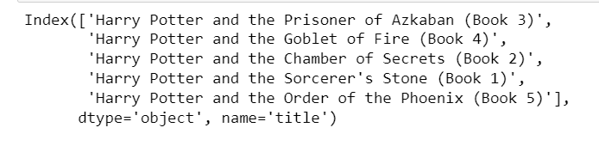
Recommendation system result
The system will predict by finding the co-ratings between users, by entering the book ID in the first model(KNN) then we pass the result into the second model(KN) to make suggestions of the 5 closest books.

Slide 24
04
Tools

Slide 25




Tools
1
3
2
4

Slide 26
05
Conclusion

Slide 27
Conclusion
Finally, I built a user similarities-based recommendation system and found that books could be recommended to users without reference to private information, such as users' interests. Only the user's evaluation of the book can be satisfied, and this method is very effective in terms of time and effort from the user. The disadvantage of this method is that the user may not have similarities with other users, so it is better to combine the types of the recommendation system for diversity and give better results.

Slide 28
Thanks!
Do you have any questions?

